Slide 1

TravelEase - Online Bus Booking System
Shree Vidyadhiraj Polytechnic, Kumta
Team Members:
B.S. Niranjan
Subrahmanya I Patgar
Rahul N Shanbhag
Vishwas Barker
Farhan Faras

Slide 2
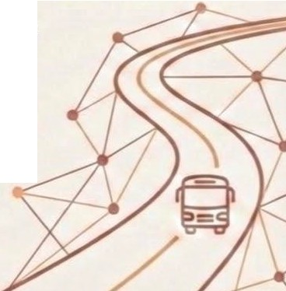
Problem Statement
Traditional ticket booking involves long manual queues.
(9
iiiiii
fta
�1�i1
� 9
Difficulty in obtaining real-time availability information.
Administrative burden of managing bookings manually.
--
�

Slide 3


Project Objectives
,� �] Provide an easy-to-use online
� booking platform.
Enable real-time ticket availability
Facilitate instant booking confirmations and efficient admin management.

Slide 4


Project Description (Core Features)
Web-based system accessible via browsers.
Search functionality by date, source, destination, and type.
��1
E:_io
Secure online payment
integration

Slide 5



User Functionalities
Browse and search for travel options.
�
Add bookings to a cart and make
_ payments.
1
01
Cancel or modify existing bookings.

Slide 6


Administrator Functionalities
...
Centralized dashboard for managing tickets.
@�
:::- aooa
User account management and monitoring.
Real-time system data tracking

Slide 7




Project Deliverables
Functional Online Ticket Booking Website.
000
Comprehensive Admin Dashboard.
.□.._{'-}
·-□-
••••
0
Booking confirmation notification system.
-
j
....
••..
0
0
··-₋
=-
15��
Technical project documentation.

Slide 8


Key Project Milestones
Requirement Analysis and System Design.
000
�@ Core Development phase.
�</>
Testing, Validation, and Deployment.

Slide 9


Constraints & Limitations
Strict adherence to time and budget.
�
Heavy dependency on internet connectivity.
LJ
o:o Complexities in security and payment gateway integration.
r---"\-"=.J

Slide 10





Work Breakdo'\Vn Structure (WBS) Overview
WBS
.,
Project Management
0
Planning, Scheduling, Risk Management
Research
Design
Development
Launch
°'
:f
�
Market Analysis,
Wireframing,
UI/UX Design,
Prototyping
Frontend, Backend,
Database, QA
Deployment,
Marketing, Post-Launch Support
User Research,
Data Collection

Slide 11




WBS:
WBS: Project Management (1.0)
Scope and Goal definition.
Resource planning and Risk management.
Project scheduling.

Slide 12


Time-Line Schedule
JAN
FEB
MAR
Total Duration: Jan 1 to Mar 15
w w w w w w w w w w w w w w w
1. KICK-OFF & PLANNING
2. RESEARCH & ANALYSIS
3. DEVELOPMENT & DRAFTING
4. FINAL REPORT
Active Phase

Slide 13


Schedule Highlights (Requirement & Design)
Jan 04 - Jan 18
Tech stack feasibility and SRS.
Jan 18 - Feb 01
Wireframes, mockups, and Database schema.

Slide 14

Schedule Highlights (Dev & Testing)
1.:.:9
Feb 01- Feb 22
Backend and Frontend development.
Mar 01- Mar 15
Unit testing, UAT, and Cloud deployment.
�

Slide 15



Cost Breakdown Structure (CBS) - Labor
Total Labor Cost (3 months): 120,000 INR
Total Developers: 5
Salary: 8,000 INR per developer/month
Based on a 3-month project duration.

Slide 16




Cost Breakdown Structure (CBS) - Material Costs
Laptop Cost (5 units):
200,000 INR
Internet Cost (3 months):
3,600 INR
Miscellaneous: 7,500 INR
Total Material Cost: 211,100 INR
Based on a 3-month project duration.

Slide 17




Risk Analysis - Technical & Schedule
Technical Risks
Schedule Risks
Delays from technical _,. challenges
Browser compatibility
_,.
Data security breaches
Requirement changes
Based on a 3-month project duration.

Slide 18




Risk Analysis - Cost & Organizational
Cost Risks
Organizational Risks
Poor team communi- _. cation
Budget overruns
Unexpected operational expenses
Stakeholder changes
Based on a 3-month project duration.

Slide 19




Risk Analysis - People & Business
People Risks
Business Risks
Skill gaps
Market.. _. competIt1on
Team member unavailability
Regulatory changes
Based on a 3-month project duration.

Slide 20


Risk Mitigation Strategy
Financial Contingency
Process & Feedback
Inclusion of 20% contingency in labor cost (24,000 INR).
Iterative feedback loops via Agile.
Based on a 3-month project duration.

Slide 21






Agile Step 1:
Sprint Planning
Estimating effort for specific feature sets.
Quantifying work required for selected user stories and tasks.
Identifying features an? defining scope for a fixed duration.
Defining scope for a fixed duration.
Commitment to a specific set of deliverables within the sprint timebox.

Slide 22



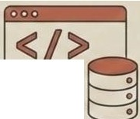


Agile Step 2 & 3: Execution & Stand-ups
Execution
Development using Spring Boot, MongoDB, and React.
⁻--⁻-
Daily Stand-ups
Daily meetings to identify roadblocks and track progress.

Slide 23






Agile Step 4 & 5: Review& Retrospecti•ve
Review
Stakeholder feedback sessions after each sprint.
Retrospective
Reflecting on the process to improve the next sprint cycle.

Slide 24
Technology Stack: MERN
Four Core Technologies: MongoDB, Express.js, React.js, and Node.js.
@) |  | ®
MongoDB NoSQL Database | - | Express.js Web Application Framework
@ |  | @
React.js JavaScript Library | - | Node.js JavaScript Runtime Environment
-

Slide 25
Database: MongoDB
NoSQL database for managing user details, packages, and bookings.
c=)
C=>
I
₋ -
I-
I
I
l=-1
NoSQL database for managing user details, packages, and bookings.
l=-1
 |  | 1- I 88 I
 |  | I=
c=)
I I
•
Flexible document-based structure for dynamic travel data.
c=)
I-
I
I-
I-
l==--1
l=-1

Slide 26
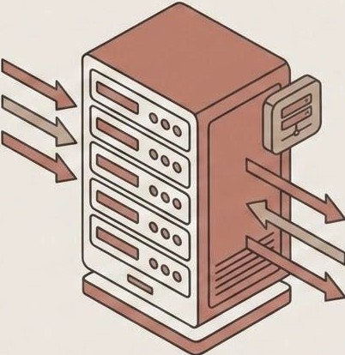
Backend: Express.js & Node.js
0 Express.js
Creating RESTful APls for authentication and payments.
e Node.js
Core logic handler for coordinating
frontend and database.

Slide 27


Frontend: React.js
Building interactive UI for destination exploration and profile management.
Em
@
000
DestinationExploration
c=:::>
¢==1
®
ProfileManagement
Personal Information
Filters
(
)CS)
) (
�
=
( )
( )
000
=
D
D
D
D
•
Efficient statemanagement for seamless navigation and data updates.
dynamic^{Component-based}responsiveand ^{architecture}niuser te^{for}far ces.

Slide 28

Programming Language: JavaScript
000
I I
D
A Used across the entire stack
V (server-side and client-side).
JS
A Ensures seamless communication
W between system components.

Slide 29



Hardware Requirements
Essential physical and infrastructure resources for development and deployment.
Computer
Modern processor, sufficient RAM, and storage for dev tools.
Server
Physical or cloud-based hosting for backend and DB.
Network
Router supporting HTTPS, SSH, and VPN protocols.

Slide 30


Software Products (Development)
VS Code
Primary source code editor and Git manager.
GitHub
Version control and team collaboration platform.

Slide 31


Software Products (Testing)
==
Google Chrome &
React Dev Tools
Browser debugging and UI inspection.
0
= Postman
API development, testing, and documentation.

Slide 32

Software Products (Management & Cloud)
000
c::== n c::::, c:::::=
� � | �□ #
Jira
Task management and progress tracking.
MongoDB Atlas
Cloud-managed database service.

Slide 33


System Component: Backend Server
nve {Express}
Built using Node.js and
Express.js.
Responsible for core business logic and processing bookings.

Slide 34
System Component: RESTful API
Handles user authorization and secure data exchange.

Slide 35


System Component: User Authentication
JSON Web Tokens (JWT) for secure session maintenance.
Encodes user info to verify identity across the frontend/backend.
,.. -[ Backend ]

Slide 36
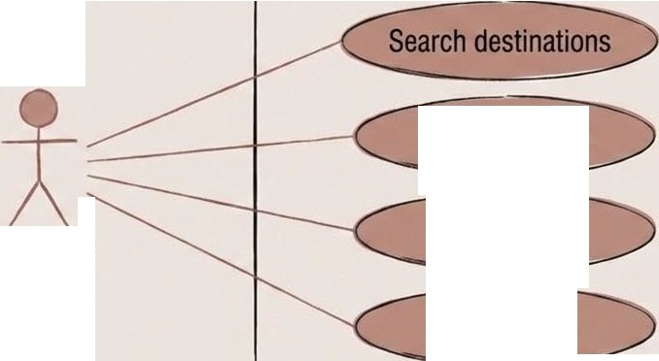
Use Case Diagram:Traveler Interaction
Travel Platform
View packages Add to Cart Book Travel
Traveler

Slide 37
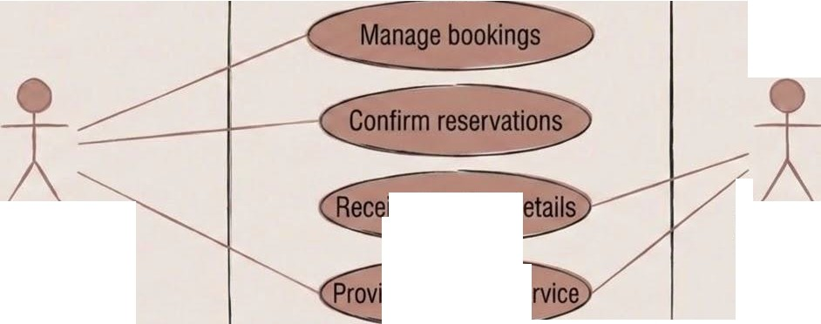
UseCase Diagram: Admin &Service Provider
Travel Platform
ve booking d
Admin
Provider
de transport se

Slide 38
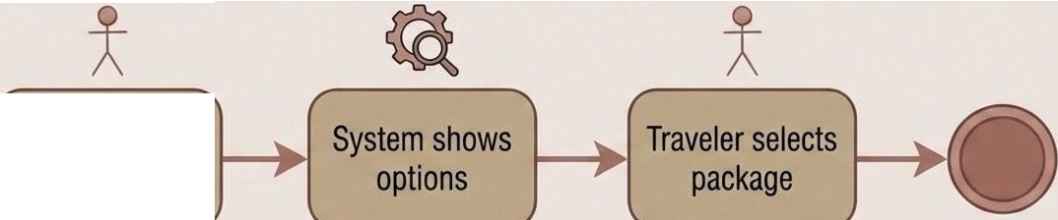

Activity Diagram: The Booking Flow
Traveler searches
Start
End

Slide 39


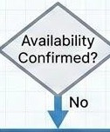


Activity Diagram:
Payment & Confirmation
Travel Platform (System)
Traveler (User)
Travel Platform (System)
Retry or Update Method
.
�©
©@
System
processes payment
No
"'
System verifies availability
Yes
User makes payment
Yes
Notify User & Offer Alternatives
System notifies ......'r
Traveler �
End �
)
End

Slide 40
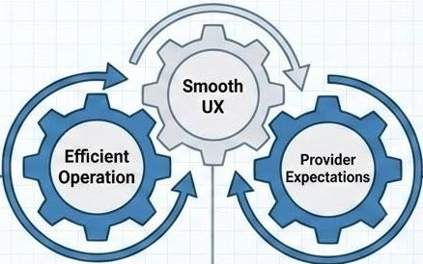
Testing Strategy Overview
@ EFFICIENT OPERATION
Automated Testing & Cl/CD Integration
Performance Optimization & Load Testing
Resource Utilization Monitoring
t_g� SMOOTH UX
Usability & Accessibility Testing
Cross-Device & Browser Compatibility
User Feedback Loops
� PROVIDER EXPECTATIONS
Compliance & Regulatory Adherence
APIIntegration & Data Integrity
Service Level Agreement (SLA) Verification

Slide 41





Compatibility & Cross-Browser Testing
Device Compatibility Testing
Cross-Browser Validation
.,
0 Testing on desktops, tablets, and smartphones.
0 Validation on Firefox and Microsoft Edge.

Slide 42


Security Testing Implementation
Secure Login &
Encryption
Secure login authentication and password encryption.
Role-Based Access Control
Role-based access control to prevent unauthorized admin access.

Slide 43
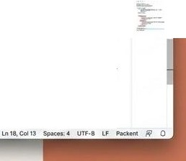
Backend Implementation: VS Code Snapshot
• •
.
0 g OJ QI
Spring Boot/MERN controllers (e.g., BookingController.java)
rn ...
[9
EXPlOREA
O 8ookingControUerjava X
src >mal,i>j1Wa >con\lffample ) <f.emo ) controller > ® Sookiigs ) e 8eokingController Java
pG511.crgo <.om,O'llltn'lJ)C-OtU0,,,0,/1/_(,,
_{p} , ....,.
vOEMO
>. 6tt
(glestContrel \er
◄ @Jlequesttlapping(" /api/bookings"'> S po�llc class BookrngConttol ler { 6
@GetAapping("apl")
Ii'
if>
�
JJ.
l!"J
vii, main
v Ii, fava
v Ii, com.eumple
vi,,...,.
v iitcontroller
9 BooldngcontrollerJava
0 Beoklngcontroller.java
•,esou,ees
• sta111
) • rt$0LKCC$
) • 18S1
>•target
� .git.ignore
.ooinom
pack.ege•k>Ck.j$0n
�ekageJson
© AEAOMEmd
II pom,xml
8
9
10
11
12
13
publlc Booking retch beokings(Booking, 1nr gs) <,
Booking ,. new GtFE:eth(8ook.lngsU:
l'eturn null:
�
Managing dependencies via pom.xml or equivalent
pom..i1MI X
I > Ill pom..xml > ©depeodencl� JO
0.- ..... +• ID I ... "' X
21
22
23
2�
25
26
27
21
32
33
34
35
36
<dependenc tes,
<dependency,
<Spr logl:,,.spring-boot-starter........eb</depingld>
<Versjon•2.1\/versJon»
</dependency>
<dependency>
<sprlog[d:i.spr1ng-boot-starter--data-Jpa</dpringld>
<Verston,-1.11</verslon.»
</dependency>
®
0
) OUTUNE
) TMl8UHt
!>,,..,.,,. ₀
</dependencies,
©oao
<fi:i011.;p--S-

Slide 44




Database Implementation (MongoDB Snapshot)
Bus Information Collection (Buses)
Real-time Booking Collection (Bookings)
r
{
"_id": "bus_001", "registration_number": "KA-10-FL-5404", "operator": "KSRTC",
"type": "AC Sleeper", "capacity": 30
}
{
DATA FLOW
"_id": "booking_98765", "user_id": "user_123", "bus id": "bus 001", "status": • CONFIRMED",
"booking_time": "2024-05-10Tl4:30:00Z", "seat_numbe r": "A4"
}
Stores bus details, including registration, operator, and capacity.
Records real-time booking transactions with immediate status updates.
Utilizing MongoDB's flexible schema for scalable and efficient data management.

Slide 45



Inference & Conclusion
User Experience
Technical Implementation
TravelEase delivers a satisfying user experience with clear info and real-time updates.
The Agile-MERN combination successfully produced a functional, scalable system.

Slide 46
